Slide 1
P1: Bookstore
By Kimberly Hilke

Slide 2


Bookstore
Begin by logging in or creating account
Browse and search for books
Filter books by category
Select a book to place an order
Admins can update available inventory and manage users

Slide 3
Tech Stack
Python
MySQL
Git

Slide 4
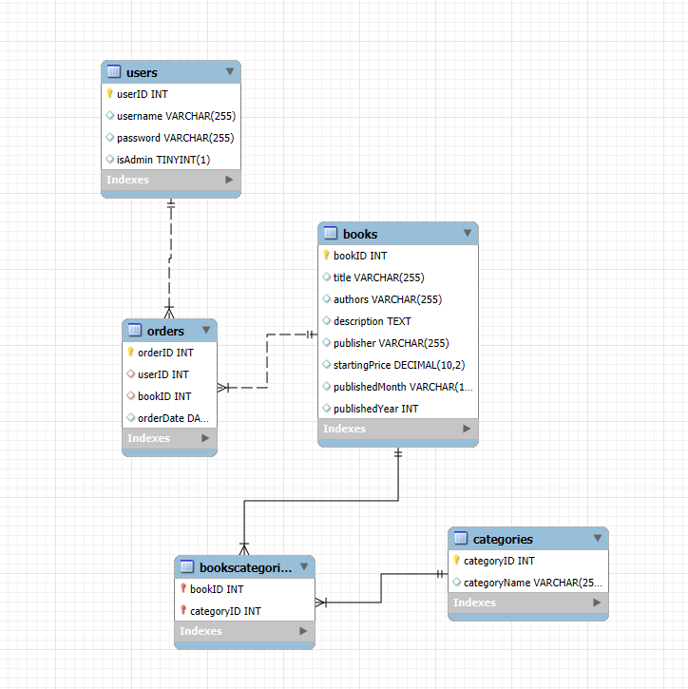
ERD
5 tables
Users, Orders, Books, BooksCategories, and Categories

Slide 5
Demo

